Slide 1

Chapter 2 Application Layer
A note on the use of these PowerPoint slides:
We’re making these slides freely available to all (faculty, students, readers). They’re in PowerPoint form so you see the animations; and can add, modify, and delete slides (including this one) and slide content to suit your needs. They obviously represent a lot of work on our part. In return for use, we only ask the following:
If you use these slides (e.g., in a class) that you mention their source (after all, we’d like people to use our book!)
If you post any slides on a www site, that you note that they are adapted from (or perhaps identical to) our slides, and note our copyright of this material.
For a revision history, see the slide note for this page.
Thanks and enjoy! JFK/KWR
All material copyright 1996-2020
J.F Kurose and K.W. Ross, All Rights Reserved
Computer Networking: A Top-Down Approach 8th edition n Jim Kurose, Keith Ross Pearson, 2020
Notes:
Version History
8.1. Updates throughout, including a lot more animations. These are the ppt files used to make Chapter 2 online lectures in Sept. 2020.
8.0 (April 2020)
All slides reformatted for 16:9 aspect ratio
All slides updated to 8th edition material
Use of Calibri font, rather that Gill Sans MT
Add LOTS more animation throughout

Slide 2




Video Streaming and CDNs: context
stream video traffic: major consumer of Internet bandwidth
Netflix, YouTube, Amazon Prime: 80% of residential ISP traffic (2020)
challenge: scale - how to reach ~1B users?
challenge: heterogeneity
different users have different capabilities (e.g., wired versus mobile; bandwidth rich versus bandwidth poor)
solution: distributed, application-level infrastructure

Slide 3
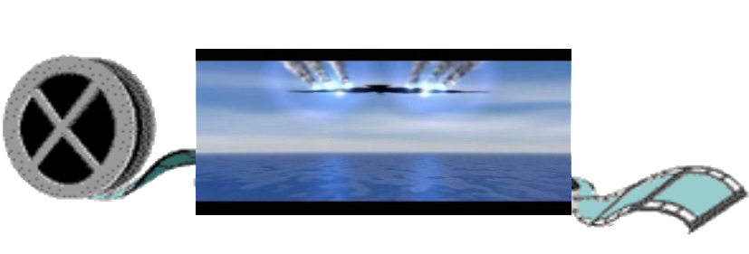
Streaming multimedia: DASH
Dynamic, Adaptive Streaming over HTTP
server:
divides video file into multiple chunks
each chunk encoded at multiple different rates
different rate encodings stored in different files
files replicated in various CDN nodes
manifest file: provides URLs for different chunks
...
...
?
...
client
client:
periodically estimates server-to-client bandwidth
consulting manifest, requests one chunk at a time
chooses maximum coding rate sustainable given current bandwidth
can choose different coding rates at different points in time (depending on available bandwidth at time), and from different servers

Slide 4

Streaming multimedia: DASH
“intelligence” at client: client determines
when to request chunk (so that buffer starvation, or overflow does not occur)
what encoding rate to request (higher quality when more bandwidth available)
...
...
?
...
client
where to request chunk (can request from URL server that is “close” to client or has high available bandwidth)
Streaming video = encoding + DASH + playout buffering

Slide 5
Content distribution problem
challenge: how to stream content (selected from millions of videos) to hundreds of thousands of simultaneous users?
option 1: single, large “mega-server”
single point of failure
point of network congestion
long (and possibly congested) path to distant clients
….quite simply: this solution doesn’t scale

Slide 6


Content distribution networks (CDNs)
challenge: how to stream content (selected from millions of videos) to hundreds of thousands of simultaneous users?
option 2: store/serve multiple copies of videos at multiple geographically distributed sites (CDN)
enter deep: push CDN servers deep into many access networks
close to users
Akamai: 240,000 servers deployed
in > 120 countries (2015)
bring home: smaller number (10’s) of larger clusters in POPs near access nets
used by Limelight

Slide 7
About Akamai
https://www.akamai.com/company?&vid=why-akamai

Slide 8
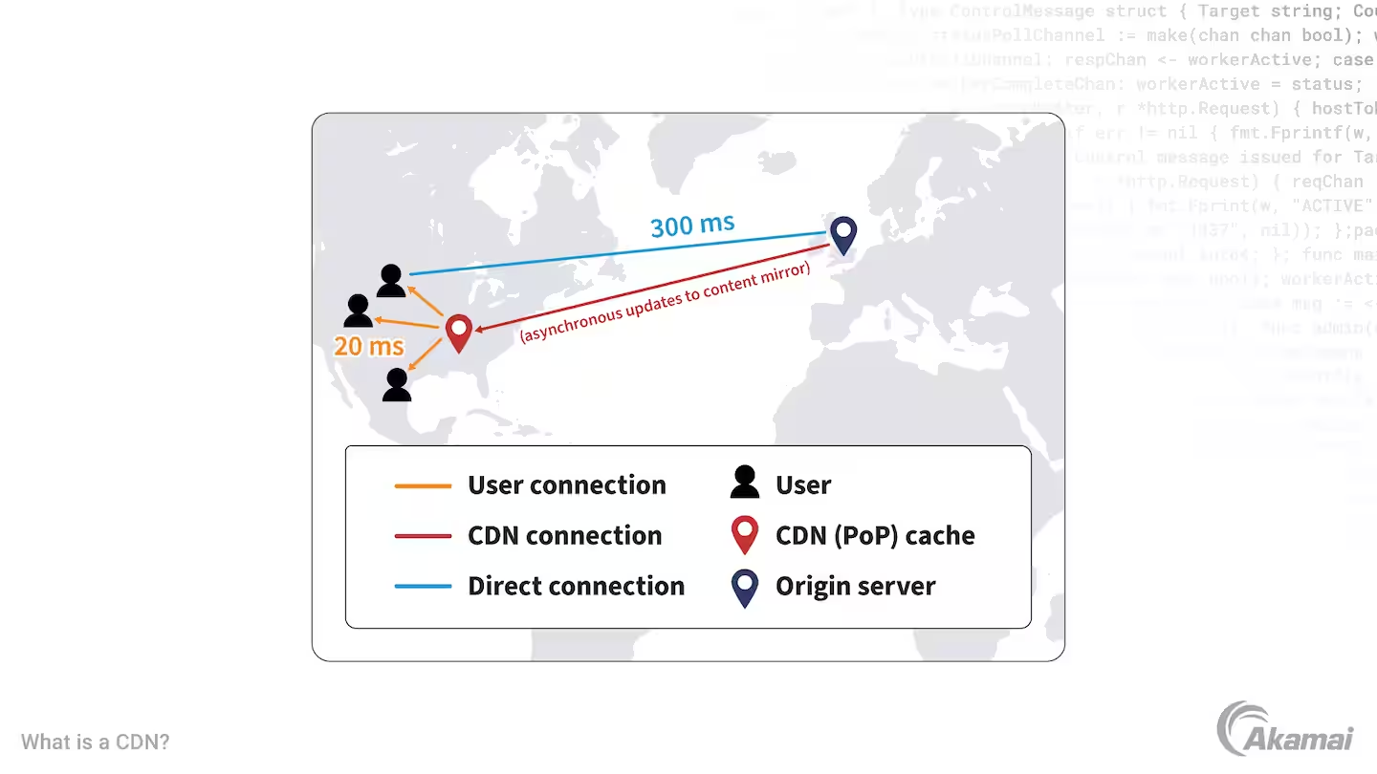
How CDN helps
CDN reduces the latency

Slide 9




How CDN works
CDN: stores copies of content (e.g. MADMEN) at CDN nodes
subscriber requests content, service provider returns manifest
using manifest, client retrieves content at highest supportable rate
may choose different rate or copy if network path congested
…
…
…
manifest file
…
where’s Madmen?
…
…
Notes:
9
Akamai: 100,000+ servers in 1000+ clusters in 1000+ networks in 70+ countries serving trillions of requests a day.
How many people use Netflix?

Slide 10
OTT: “over the top”
…
…
Internet host-host communication as a service
…
…
OTT challenges: coping with a congested Internet from the “edge”
what content to place in which CDN node?
from which CDN node to retrieve content? At which rate?
…
…
Notes:
10
peak load: 7million viewers, 2 Tbytes via

Slide 11


Case study: Netflix
Amazon cloud
upload copies of multiple versions of video to CDN servers
CDN
server
Netflix registration,
accounting servers
Bob browses
Netflix video
Manifest file, requested
returned for
specific video
CDN
server
2
1
3
Bob manages Netflix account
CDN
server
4
DASH server selected, contacted, streaming begins
Notes:
This slide retired, since there’s the new Netflix example which is visually better

Slide 12
CDN content access: a closer look
Bob (client) requests video http://netcinema.com/6Y7B23V
video stored in CDN at http://KingCDN.com/NetC6y&B23V
1. Bob gets URL for video http://netcinema.com/6Y7B23V
from netcinema.com web page
2. resolve http://netcinema.com/6Y7B23V
via Bob’s local DNS
1
2
6. request video from
KINGCDN server,
streamed via HTTP
5
Bob’s
local DNS
server
netcinema.com
3. netcinema’s DNS returns CNAME for
http://KingCDN.com/NetC6y&B23V
4
3
netcinema’s
authoratative DNS
KingCDN.com
KingCDN
authoritative DNS
Notes:
This slide retired, since there’s the Netflix example which is visually better

